Slide 1


GRAPHICAL AND MULTIMEDIA SYSTEMS
Robot Arm
Adviser: Dr.Enric Martí Gòdia
Master in Computer Engineering
Work Group #1
Group members:
Md Ashraful Alam Milton
Negin Moradi
Pouya Ahmadmonfared
Marcelina Izworska
Kian Seif

Slide 2
Outline
1. Introduction
2 Robot Arm Project
3. Development
4. Results & Demo
5. Conclusion and Future works
6. Bibliography
7. Question & Answers

Slide 3
1 Introduction
Computer Graphics is a revolutionary technology that changes the aspect of how we interact with computer.
From Animation movie to Flight simulator, computer graphics is a very practical and versatile technology.
In PBL(Project Based Learning ) method in our course we have done a Computer Graphics Project titled Robot Arm

Slide 4
2 Robot Arm Project
Dr. Enric Martí Gòdia proposed us several project like Lights Simulation, Robot Arm, a Computer Game (3D Tetris)
After discussion we selected Robot Arm project
This Robot Arm should have several segments which have their own constraint for movement.
Showing the sample for previous students projects help us to have more idea about the robot arm.

Slide 5
2.1 Inverse Kinematics
Inverse kinematics refers to the use of the kinematics equations of a robot to determine the joint parameters that provide a desired position of the end-effector.
Specification of the movement of a robot so that its end-effector achieves a desired task is known as motion planning.
Inverse kinematics transforms the motion plan into joint actuator trajectories for the robot.

Slide 6
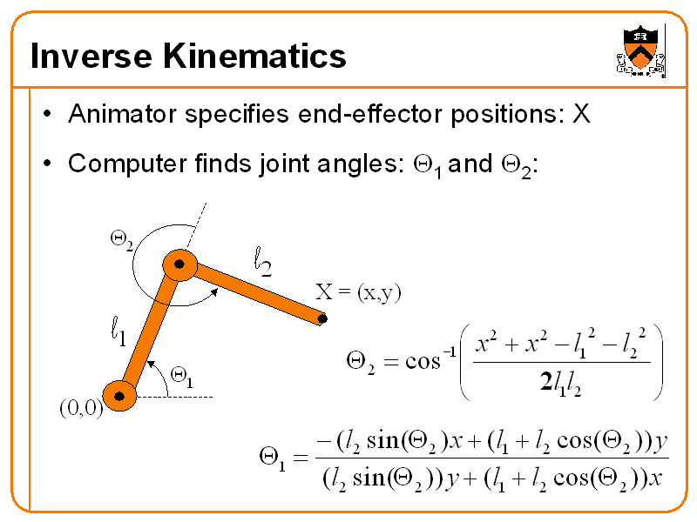
2.1 Inverse Kinematics

Slide 7
3.1 Platform & Development Environment
Operating System: Ubuntu, Windows
IDE: QtCreator, Eclipse
Graphics Api: OpenGL 3.0, OpenGL 3.3
Programming Language: C,C++
Framework: Qt GUI, Eigen

Slide 8
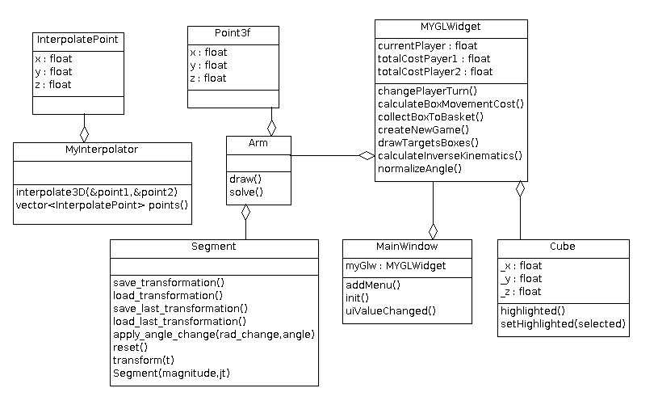
3.2 Class Diagram

Slide 9
3.3 Application Structure
User Interface: The application has one window named MainWindow. It was created by QtCreator. It has drag and drop facility and easy to design. Every 30 mili seconds this window is refreshed and redrawn.
OpenGL Widget: to facilitate opengl calls in ui window, we extended the QGLWidget provided by default in Qt framework. The extended class is called MYGLWidget.
User Controls: On the right part of MYGLWidget there are many controls for user like Camera, Scale, Rotate, Translate
Robot Arm: Robot Arm is constructed by 6 segment of Segment class that forms the Arm class.

Slide 10
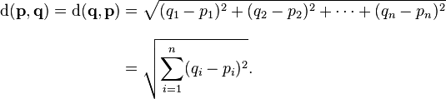
3.4 Calculate Cost of Moving a box to Basket
We Used Euclidean distance between two target box and reference or pivot point of robot arm to calculate the distance which will be used as cost in moving boxes. Lower the distance/cost better the performance of arm movement.

Slide 11
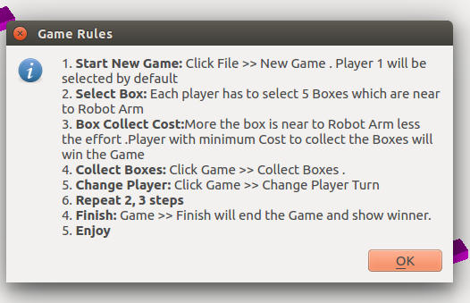
4.1 Demo & Results : Game Rules

Slide 12
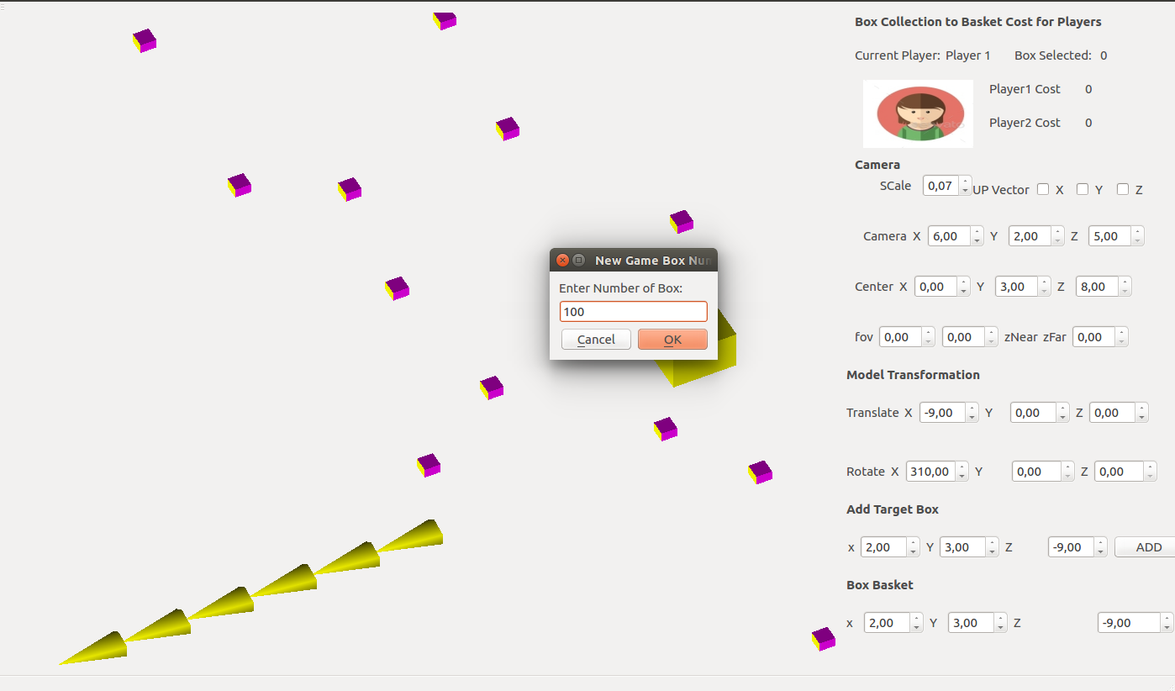
4.2 Demo: New Game

Slide 13
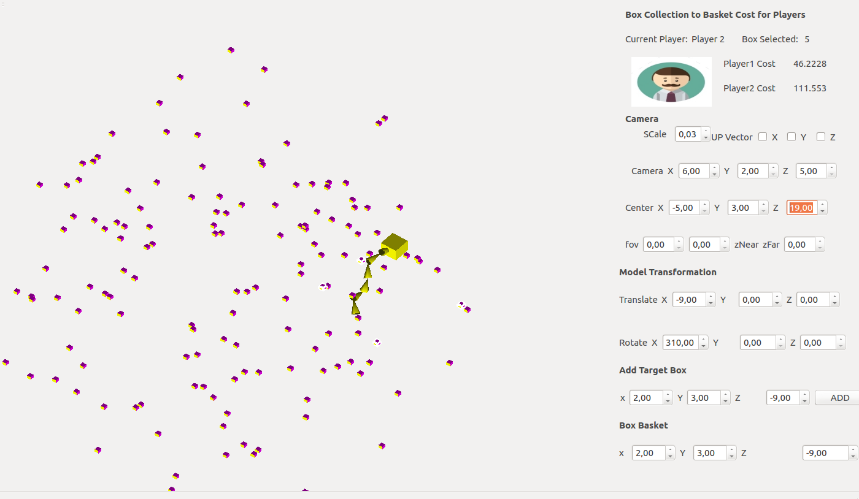
4.3 Demo: New Game Created

Slide 14
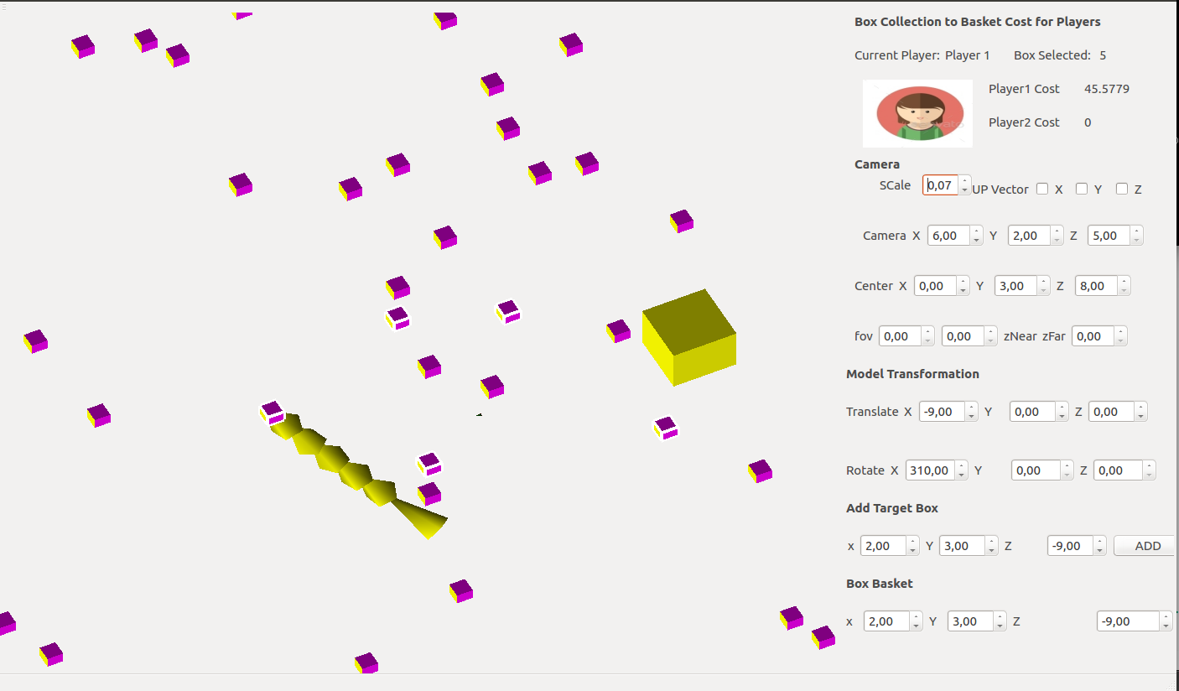
4.4 Demo: Player 1 Box Selection

Slide 15
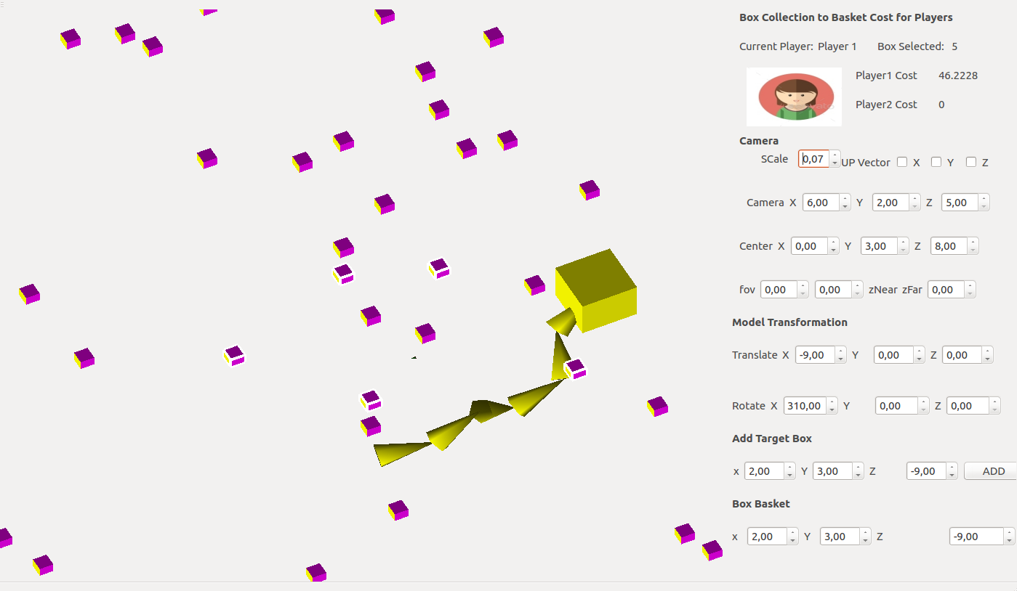
4.5 Demo: Player 1 Box Collected

Slide 16
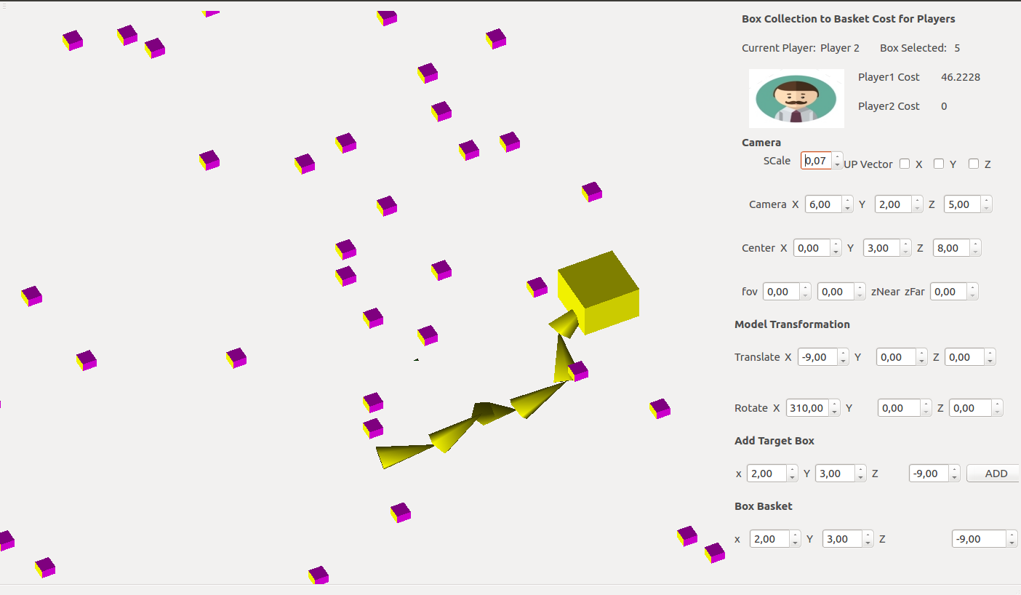
4.6 Demo: Turn to Player 2

Slide 17
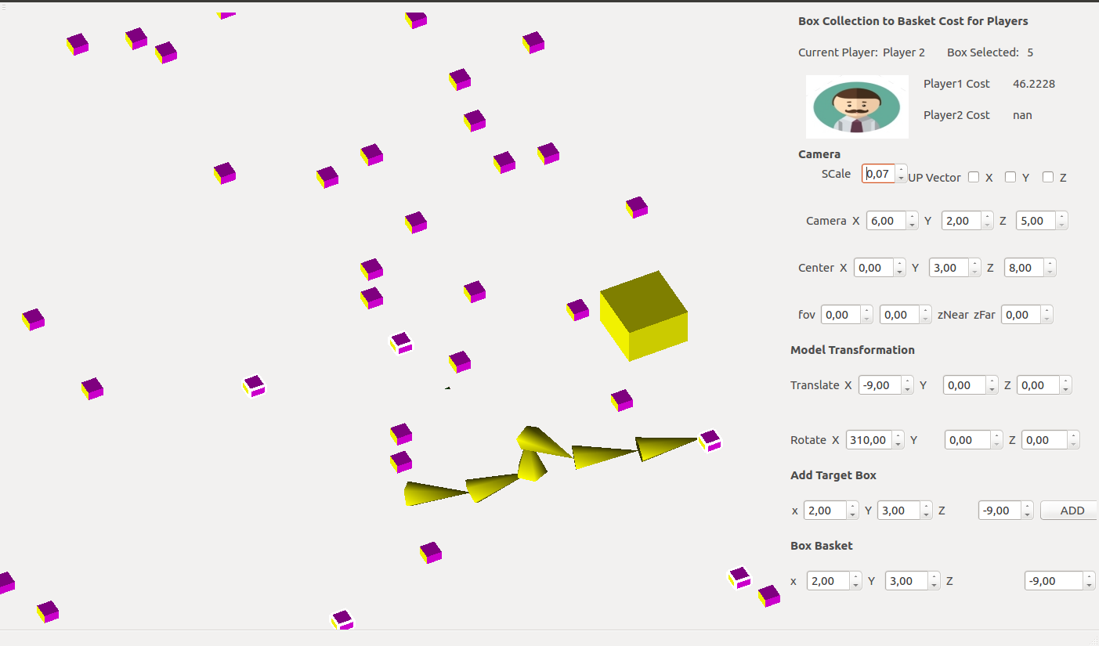
4.7 Demo: Player 2 Box Selection

Slide 18
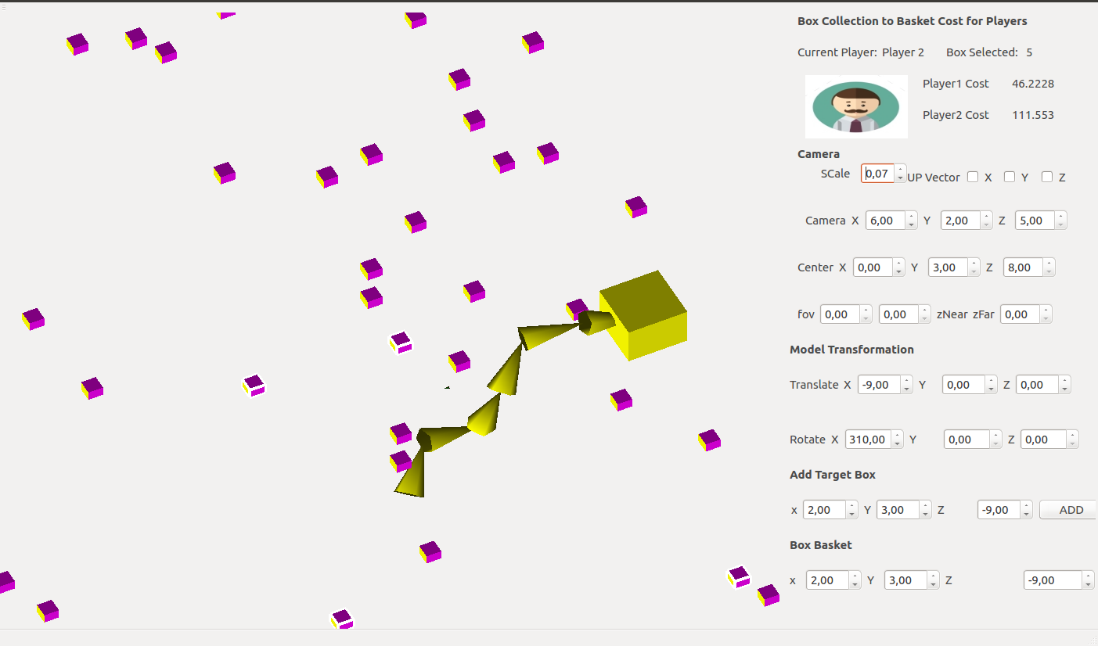
4.8 Demo: Player 2 Box Collected

Slide 19
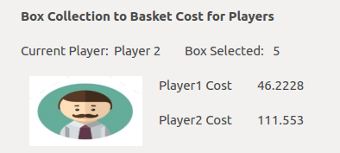
4.9 Cost of Player 1 and Player 2 to move the boxes

Slide 20
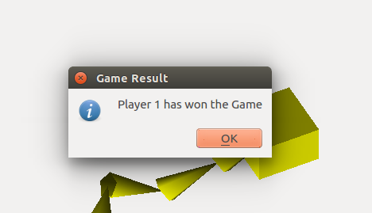
4.10 Game Finish & Result

Slide 21
5 Conclusion
Robot Arm project was useful to us learning computer graphics.
Though Robot Arm project has some limitations due to our lack of experience, still it can be used to plan and study robot arm.
Our Robot can find the object in 3D which is within its range.
We have learnt significant knowledge in robot arm movement by doing this project.

Slide 22
Future Works
Use Arm Segment with different degree of freedom: Instead of n-segment triangles to act as robot arm where each segment is same type and each segment has same degree of freedom, Different type of segment with different degree of freedom can be used to construct the robot arm which is more flexible.
Use .obj model: We also draw the robot arm by using primitives. .obj model could be used to load the model.
Create Surrounding environment: We also did not create environment for robot arm like Room, Table. Surrounding environment can be created to a more natural view.
Smoother Animation: different types of interpolation techniques can be used for better and smoother animation.

Slide 23
6 Bibliography
http://cerbero.uab.cat/moodle2/course/
https://www.opengl.org/
https://www.khronos.org/opengl/
https://developer.nvidia.com/opengl/
http://www.qt.io/
https://bitbucket.org/samirmenon/scl-manips-v2/wiki/vision/kinect
http://faltastico.tumblr.com/post/90660911262/giving-kinect-libfreenect-a-spin-on-ubuntu-14-04
http://eigen.tuxfamily.org/index.php?title=Main_Page
http://en.wikipedia.org/wiki/Euclidean_distance

Slide 24
6 Bibliography
http://en.wikipedia.org/wiki/Jacobian_matrix_and_determinant
http://en.wikipedia.org/wiki/Inverse_kinematics
http://www.3dkingdoms.com/ik.htm
http://en.wikipedia.org/wiki/Trilinear_interpolation
https://www.opengl.org/wiki/Skeletal_Animation
http://zetcode.com/gui/qt4/
https://github.com/michaelforney/inverse_kinematics
http://www.sjbaker.org/steve/omniv/opengl_lighting.html

Slide 25


Slide 26

7 Question & Answers

